Slide 1
IBM Stock Trader sample for Kubernetes - Basic
Kubernetes (OCP, EKS, AKS, IKS, GKE, TKG)
IBM Cloud
IBM
DB2
GET
API Connect
JDBC
Insert, Select,
Update, Delete
IEX
Trader (Java UI)
Portfolio
Stock Quote
GET
GET
POST/GET
PUT/DELETE
Browser
Broker
Legend:
Blue: Open Liberty
Red: Quarkus
Green: Dependency
This open-source application demonstrates how to build a cloud-native application out of microservices, which connect to services in the cloud. There is a GitHub org, at https://github.com/IBMStockTrader, which contains a repository per microservice, as well as an operator repository and a GitOps repository.
When code is committed to a microservice repository, a webhook kicks off a GitHub Action that builds and pushes an image to Quay, and updates a StockTrader CR yaml in the GitOps repo with the tag for the new image, which kicks off another GitHub Action that deploys/updates the application to a Kubernetes cluster in the cloud.

Slide 2
IBM Stock Trader sample for Kubernetes – with optional pieces
Solid Border:
Required
Dashed Border:
Optional
Kubernetes (OCP, EKS, AKS, IKS, GKE, TKG)
IBM Cloud
loopctl
Looper
IBM
DB2
Redis
API Connect
GET
JDBC
Insert, Select,
Update, Delete
Jedis
GET
SET
IEX
Trader (Java UI)
Portfolio
Stock Quote
Cloudant
GET
GET, POST
GET
POST/GET
PUT/DELETE
Browser
Broker
Account
IBM
ODM
Watson Tone Analyzer
POST
POST
JMS
Put
Broker Query
Legend:
Blue: Open Liberty
Purple: tWAS
Red: Quarkus
Yellow: Node.js
Green: Dependency
Tradr (Node UI)
IBM
MQ
AWS
Kafka Send
Notification Service
API Gateway
MDB
onMessage
Notification (Slack)
IBM Event Streams
Messaging
Slack
POST
POST
POST
Uses an Istio routing rule here
Lambda
Kafka
Receive
GET
Trade History
GET
Mongo
Notification (Twitter)
POST
Twitter
POST
Twitter4J

Slide 3
The “umbrella” operator for the IBM Stock Trader sample
https://github.com/IBMStockTrader/stocktrader-operator
Wraps the helm chart at https://github.com/IBMStockTrader/stocktrader-helm
Described at https://medium.com/cloud-engagement-hub/the-ibm-stock-trader-operator-part-1-usage-9737a04b6848
Handles installation and configuration of the sample
No “day 2” operations – but does support altering the configuration and pushing that out
All microservices installed by single operator
The application as-a-whole is described by the CR you create from the CRD
No having to install each microservice separately
Can install the sample via a single “oc create -f stocktrader.yaml” command, or via the form UI
Prerequisite services are NOT installed by this operator
Helps configure connections to pre-provisioned prereq services
Might be interesting to explore an “operator of operators” pattern
Could potentially drive the IBM Cloud operator to help with hooking up to resources out in our cloud

Slide 4
MicroProfile features used in IBM Stock Trader
Green means the feature is explicitly used
Yellow means the feature is not explicitly used, but out-of-the-box behavior is implicitly available
Red means no usage of the feature
The non-Liberty microservices, like the Node.js-based Tradr and the tWAS-based Notification-Twitter, are not shown here since there is no MicroProfile available there
Messaging is the only traditional EJB-based microservice. It’s an MDB with no http endpoint
We usually use the fault tolerance features of the OpenShift Service Mesh (Red Hat’s productization of Istio) in lieu of MicroProfile Fault Tolerance
MicroProfile REST Client (with JSON-B) is used for all http/https calls between microservices
Trade History also uses mpReactiveMessaging

Slide 5
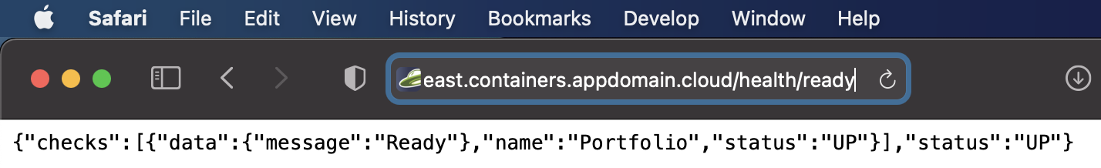
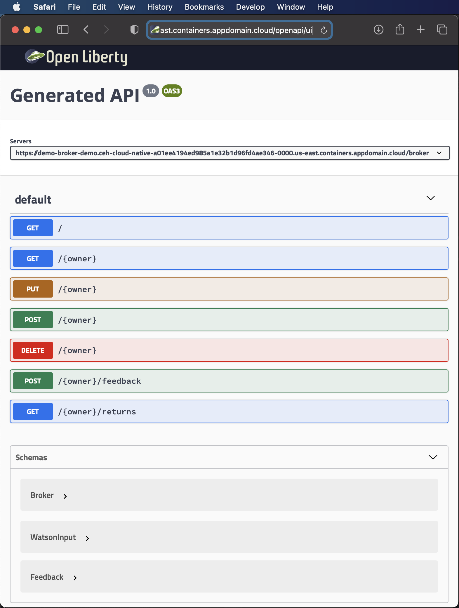
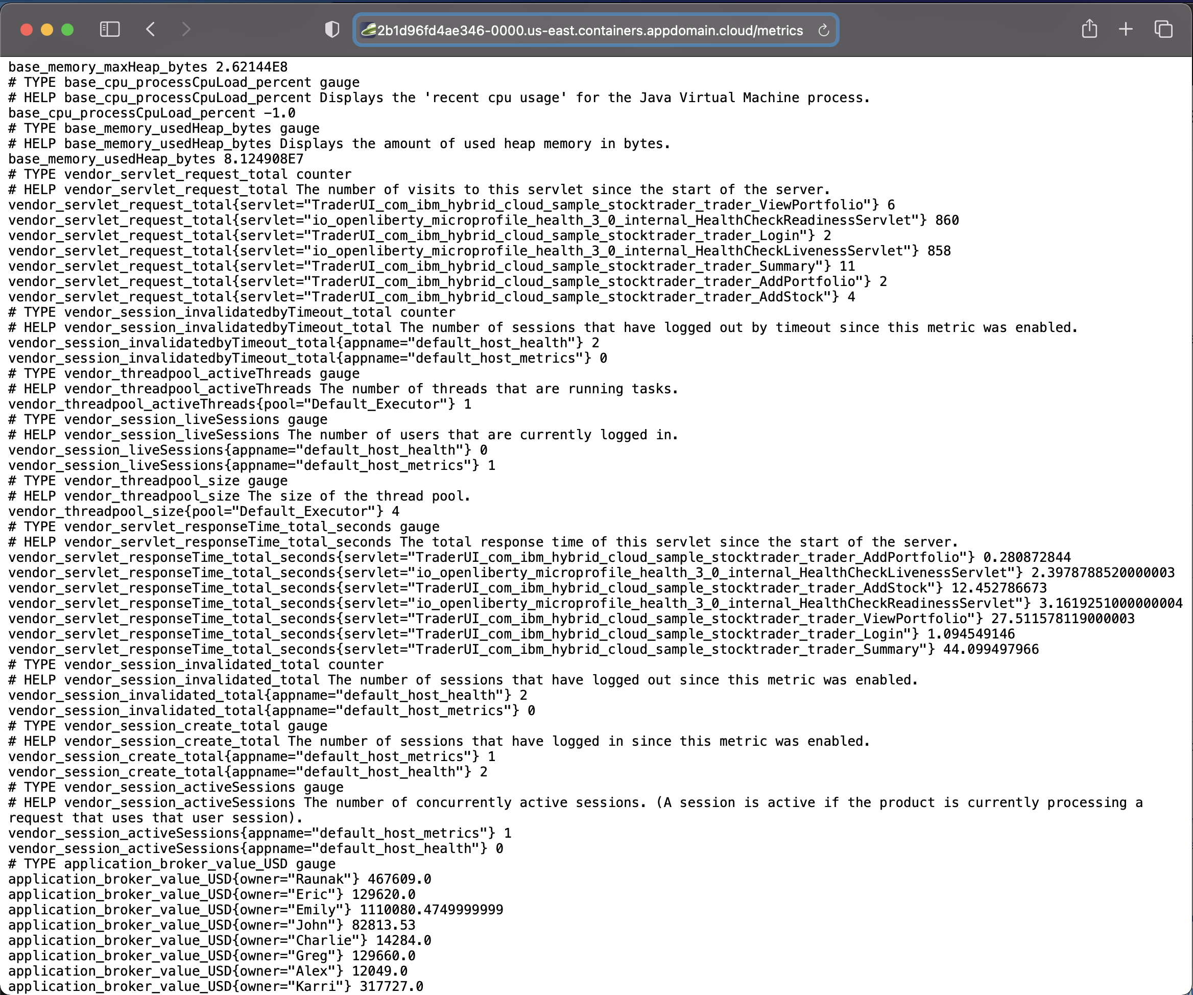
MicroProfile endpoints from IBM Stock Trader
Health:
OpenAPI:
Metrics:

Slide 6
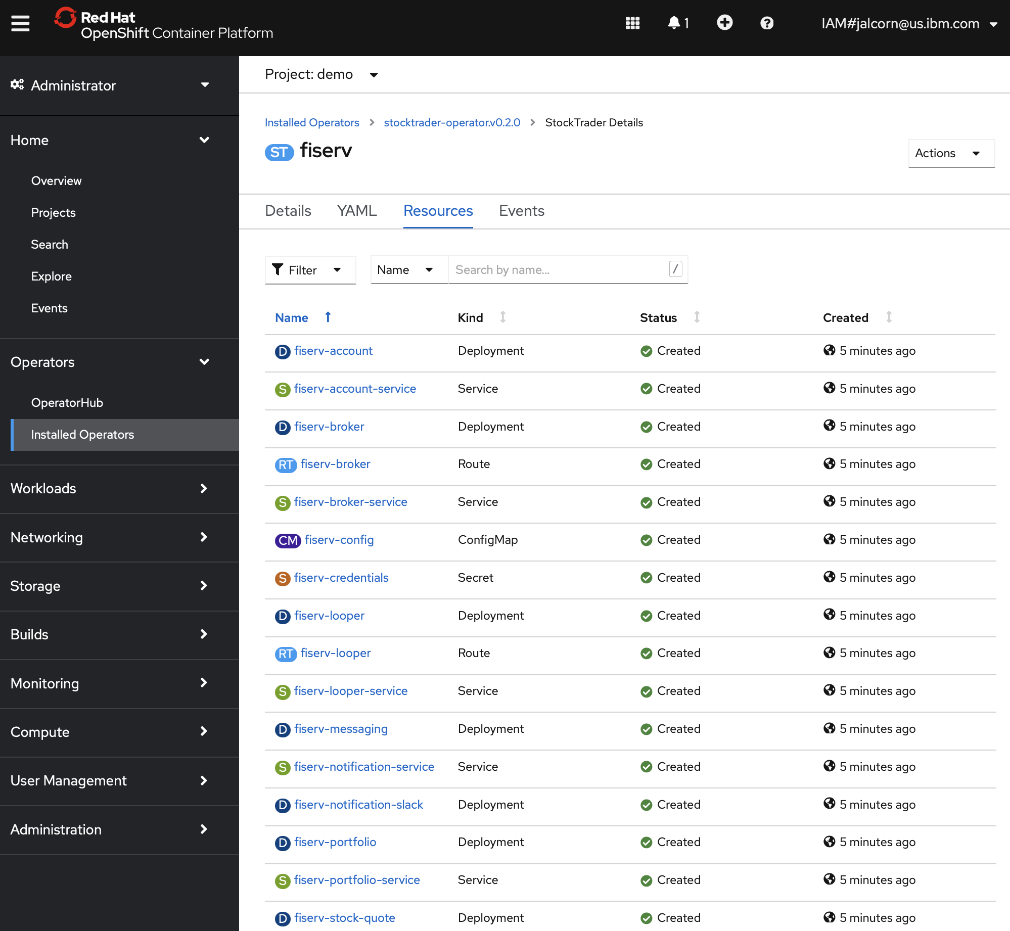
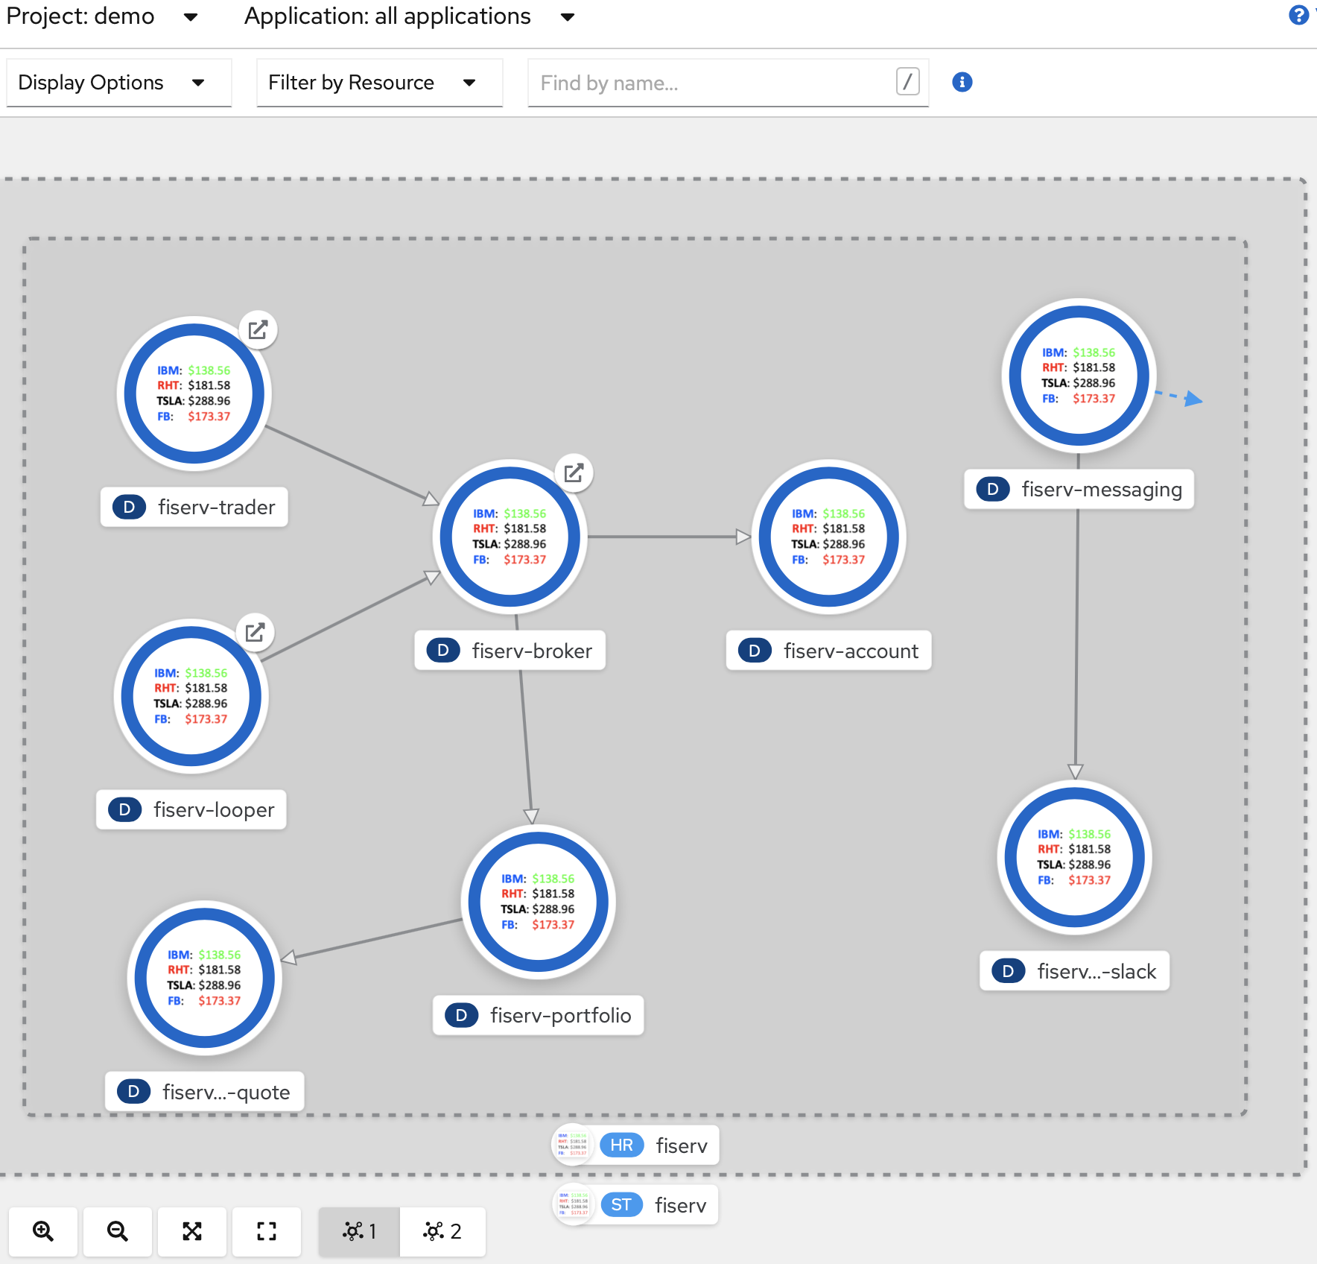
IBM Stock Trader microservices visualized in the OpenShift console

Slide 7
CQRS in IBM Stock Trader
Broker
GET /broker
javax.cache
Looper
Broker Query
RH Data Grid
GET /broker/{owner}
(or other JCache provider like Redis or Hazelcast)
(or other JDBC provider)
Trader
POST /broker/{owner}
Portfolio
DB2
PUT /broker/{owner}
Kafka
Tradr
(Confluent or RH AMQ Streams)
DELETE /broker/{owner}
Account
Cloudant
CQRS would be optional (based on a boolean in the CRD, set via the form in the operator and passed as an env var to each pod). If not enabled, the GET calls would go to Portfolio and Account like usual, and nothing would get published to Kafka

Slide 8




Source for Stock Trader footer image
https://github.com/IBMStockTrader
Source for Stock Trader helm chart/operator icon
IBM: $138.56
RHT: $181.58
TSLA: $288.96
FB: $173.37

Slide 9
Approaches for HashiCorp Vault integration with microservices
Code directly to Vault in your microservice Java classes
Pros: Very secure – secrets not exposed in files or env vars
Cons: Must train developers to use proprietary code in every microservice, and vendor lock-in to HashiCorp as the secrets manager
Use the Vault injector to get an init container and sidecar
Pros: No impact to developers, and no vendor lock-in for microservices
Cons: Overhead of extra containers per pod, and risk of secrets getting disclosed to unauthorized parties that might see the files or env vars
*New*: Use the VaultConfigSource for MicroProfile Config
Pros: No impact to developers (if already using standard MicroProfile programming model of CDI injection of config properties), and no vendor lock-in. Also, no overhead of extra containers per pod, or disclosure risk
Cons: None!

